Slide 1
PHILOSOPHY OF ONLINE
COMMUNICATION AS
IT RELATES TO
ONLINE LEARNING
Hear information from Teacher
Read information from a textbook
Look further into information that sparked an interest (more readings, discussions with peers, etc)
Create meaningful understandings of the information in a way that is relevant and personalized to the student
Breanne Quist

Slide 2
Reading about a topic
Write a web post / blog
Pose a question that arose from readings
Answer a question from a peer
Interest forms about a new topic or deepens for the current topic
Processing Information
The way we process information in the 21st century should be different than the centuries past. Before we would read a textbook, fill out a worksheet and be required to reiterate the information on a test. 21st century learning should take a more rounded approach where topics and ideas are connected and learning about one topic may lead to discussions and interest in another topic.
“When students are able to talk about their learning and make connections, that is when deep, meaningful learning takes place” (Mary-Lynn Epps).

Slide 3
The Future Learner
Siemens (2004) talks about how “learners have to learn how to learn and evaluate new information” and “learners of the future need to be exposed to different fields so that they can see the connections between the information in the fields”. With this in mind the learner of the future will know more about how they are learning and not just what they are learning. This is important with life outside and beyond the classroom as we are teaching our students to ask questions and think for themselves, not to just take everything they hear as absolute truth.
Evaluation of new information
Exposure to different fields to see connections between them
The learner of the future with a well rounded knowledge that will continue and be useful into the workplace

Slide 4
Remembering information
Apply information
Evaluate information
Explore information
Make connections with information
Driving Student Learning and Achievement
Connections are the one of the biggest gears driving student’s learning and achievement and I believe that making connections is the greatest asset but having the contributions of constructivism and behavior are a great help as well.
Connectivism
Constructiv-ism
Behaviourism
How to Reach the Ultimate goal
Bloom’s taxonomy suggests that the most active learning method is remembering but to get there, students need to be able to apply the information they have learned, as well as evaluate and analyze it. Through this students may make connections (text-to-text, text-to-world, text-to-self) and through that decide to explore even more information to make more meaningful and deeper connections.

Slide 5
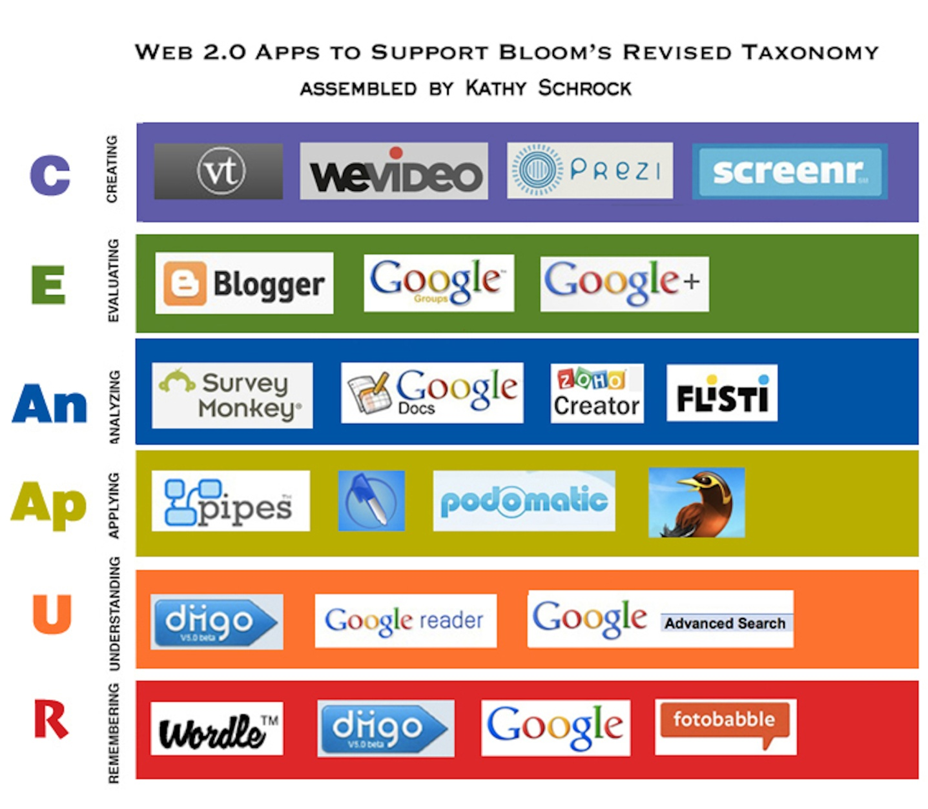
Support for Student Success
With anything, if there is no support, something in bound to fail. If we give our students the information but do not give them the support to explore the information and ways to help make it relevant to them, we are not supporting their learning and because of this there is a greater probability of failure.
This chart shows different apps and online tools to help support student learning and achievement through all the areas of Bloom’s taxonomy. If we allow our students the opportunity to explore these options then they are able to find what works for them.
This week we had the task of completing a comic strip showing what we thought education would look like in 25 years. I found this very exciting because instead of having to sit in front of a blank paper and write down all of my thoughts, I was able to show it with pictures and diagrams which is how my brain works best to process information. I also found this to be a lot more of a dynamic way of showing my thoughts (as I am also doing with this presentation).

Slide 6
Students
Peers
Teacher
Success
Students are the biggest driving force behind their own learning. If students want to succeed they will. If they want to put in the least possible effort, that is a choice they can make as well. As much as we would like to think that teachers could force students to do as much as we want them to, students will always stop when they want. We as teachers (and peers) need to find ways to encourage students (and peers) to strive for greatness. This is done mostly through communication and I believe collaboration which in turn means that one person striving for greatness in a collaborative setting will hopefully pass that along to their peers and get their ‘gears’ working. When we allow the students the opportunity to drive their own learning, we as teachers also learn things through them.
Other ways of having students engaged and willing to learn is to create meaningful and interesting opportunities to learn, much like our peers gave us the same opportunities the past few weeks.
Personalized Learning
Downes states “the effective use of online conferencing will be a skill as important in the future as are the social skills taught in schools today. Imagine the best desktop computer you can imagine, slung over your shoulder like a slim handbag, connected to the billions of resources available on the internet, supporting instant multimedia communications anywhere on the planet, and you have a picture of the tool available for education within the next decade. The development of such a tool makes it not just possible, but inevitable, that education of the future will become deeply personalized.” I hope that this is true. Education and learning needs to be personalized for students to get the most out of their education and to gain the skills necessary to thrive and succeed beyond the classroom.
Critical Thinking videos
Comic strips / Avatars
Icebreakers / ‘getting to know you’
Synchronous: (collaborate, skype, f2f)
Asynchronous: (blogs, wikis, personal websites)

Slide 7
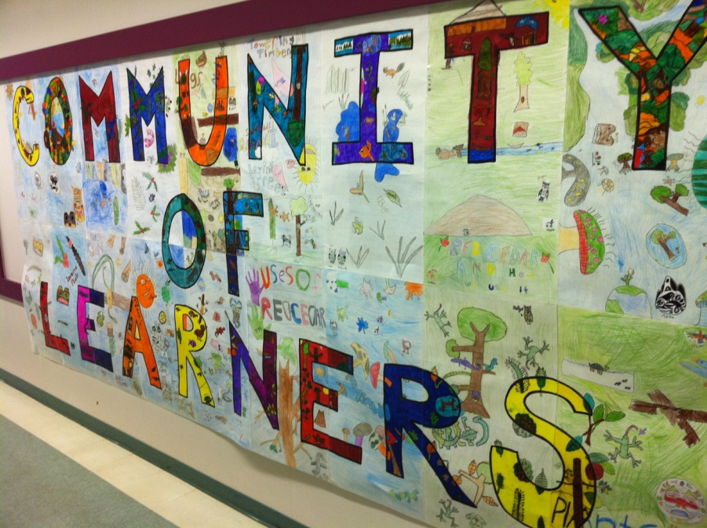
Learning Community
When reading E-coaching Tips from Rider University, some points caught my attention, particularly with a study that was conducted relating to the “learning community” as I have a lot of experience with using a community of learners approach so it was interesting to read about it in a online setting.
Boettcher (2009) found that: “the study participants also attempted to define a “learning community” as distinct from a more general community. Their responses included a distinctive characteristic of shared responsibility for learning. Participants in a learning community feel they are responsible in part not just for their own learning but for others’ learning, too. So, yes, building community is more important in an online course because it contributes to a feeling of connectedness, support, and shared experiences, and by extension, to retention and learning success. Some of the techniques for community building, such as sharing pictures, favorite movies and music, and working collaboratively on small and large assignments and projects, naturally create common areas of feelings, values and interests. Even if feelings and values are different, members of a community respect the legitimacy of such feelings and values. Feelings of support and connectedness are part of the social and cognitive presence.”
This is a collage that my students in my final practicum class made with the neighbouring classroom. I like how it shows everyone working together to create one amazing piece of artwork. Each group of students had a letter to colour and they had to draw a picture of something that they were learning about in class that would showcase a community. All the students talked and decided that they should do a forest because they were learning about the environment and how everything in nature has a purpose and it all works together. I hope to one day have a set up where I can do a virtual collage with my students using the same idea.

Slide 8
Teacher
Parent
Student
Before
I feel that when I talk to most of my colleagues and when I started out teaching DL, as I never got f2f time with my students, there was almost a “communication pyramid” with myself talking to the parents who would then relay information to their child (the student).
Teacher
Parent
Student
Peers
Now
I feel more connected to my students as I spend more of my time communicating with them. Students are also relying on their parents to fill in some of the gaps of information they may have but they are taking more ownership of their learning because the instructions and communication is going directly to them. In the coming years I hope to include more collaborative work with my students which will foster a greater community of learners and encourage communication with students and their peers; Much like this course and how it was set up for us to succeed as a ‘community of learners’.

Slide 9
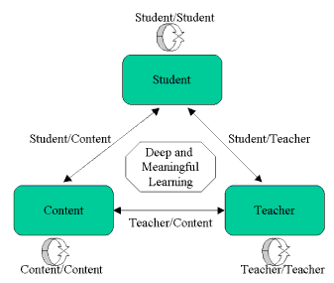
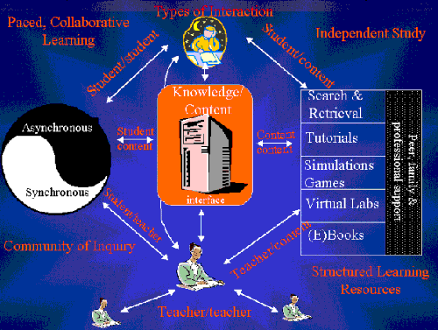
When I came across this model in my readings I thought it was very interesting because it shows that the student not only interacts with the teacher and other students but that the student also interacts with the content. This only deepens my thinking that the shift is happening to the 21st century where students are not only learning from teachers but they are also taking responsibility for their own learning. Through deeper exploration of topics by the students, I think teachers are beginning to learn from students. I know that with my students I have learned some things from them that I would not have otherwise learned solely based on the students taking a connection they could make to the subject they were studying and researching it further because it interested them.
Anderson (2003) cited the model: Modes of Interaction in Distance Education from Anderson and Garrison, (1998).
Anderson (2003) also cited this model: A Model of Online learning
Looking at this model I know many people who would be very happy to see games and virtual labs as a way of supporting learning. If people are at a distance learning, it would be very hard to have all the materials necessary to complete biology or chemistry labs so allowing students to use virtual labs means that they can learn from home without being at a disadvantage.
This model shows that there are many different ways to learn and to support learning and I like that it is not biased in any direction. There are pros and cons to working both completely synchronously or asynchronously but I believe that those will differ from person to person based on circumstances. Showing the balance with the ying and yang is a great way to incorporate both sides, however much or little they may be utilized. The 21st century learner is going to need different types of interaction and stimulation than students 10 years ago so allowing for the collaborative learning and community of inquiry will give them the tools for success.

Slide 10
Summing it up
When starting this course I was already aware of the “community of learners” approach to teaching and how amazing it is to see the students taking ownership of their learning and producing amazing work; and I still feel this way. Throughout the past few weeks I have found that this concept has been more solidified and I feel like I have been able to a student in this concept for the first time instead of just the facilitator. In OLTD 502 Jean and I presented on this topic and I was very happy to see it coming alive in 503. This course has also opened my eyes to many more tools that I am excited to take to my students to help supplement the inquiry and “learning community” philosophy (better ways and tools for my students to communicate with me and their peers). Overall my thoughts and views did not change very much, they just grew and developed more. I am very excited to see where this will take me (and my students) with our learning in the future.

Slide 11
References
Overbaugh, R., & Schultz, L. Bloom’s Taxonomy. Retrieved from http://ww2.odu.edu/educ/roverbau/Bloom/blooms_taxonomy.htm
Siemens, G. (2004, Dec 12). Connectivism: A learning theory for the digital age. Retrieved from http://www.elearnspace.org/Articles/connectivism.htm
Downes, S. (n.d.). The future of online learning. Retrieved from http://www.westga.edu/~distance/ojdla/fall13/downes13.html
Boettcher, J. (2009, May 14). Rider university online e-coaching tips. Retrieved from http://www.rider.edu/files/tlc-RiderTip3BldgCommunityFS.pdf
Anderson, T. (2003, Oct). Getting the mix right again: An updated and theoretical rationale for interaction. Retrieved from http://www.irrodl.org/index.php/irrodl/article/view/149/230
Schrock, K. (Designer). (n.d.). Web 2.0 apps to support bloom's revised taxonomy. [Web Graphic]. Retrieved from http://www.schrockguide.net/uploads/3/9/2/2/392267/web20_blooms.jpg
Epps, M. (2012, Nov 16). Interview by B Quist [Personal Interview]. Brining inquiry online., Nanaimo, BC.

